Slide 1
Course Objectives
By the end of this workshop, you will be
able to:
Define the four core leadership strategies.
Identify the strategy you use most often.
Adjust your approach or strategy to reflect the capabilities and desires of your employees.
1-1

Slide 2
What Is Strategic Leadership?
A method for leaders to develop their people and increase productivity.
Choosing a leadership strategy based on an employee’s capability and desire to do required tasks.
1-2

Slide 3
Management vs. Leadership
Management can mean to be in charge, to control, or to take responsibility.
Leadership usually means to inspire, to motivate, or to help others achieve important goals.
1-3

Slide 4
Management
Elements of management include:
Defining each employee’s tasks or roles
Checking up on their work
Giving instruction
Correcting employees when they make errors
Tracking information about results
1-4

Slide 5
Leadership
Elements of leadership include:
Raising motivation to perform required tasks
Developing an employee’s skill and ability to perform the tasks
Improving work processes
Striving for higher and better results, believing in the employee’s potential
1-5

Slide 6
A Strategic Leader assesses…
Capability: The knowledge, experience, and skill an employee brings to a particular task or activity; the employee’s need for task structure and instruction
and
Desire: An employee’s confidence, commitment, and motivation to accomplish a specific task or activity; an employee’s need for consideration and support
1-6

Slide 7
Capability
To determine Capability, ask performance-focused questions such as:
How is the work going?
Which tasks should I assign to which people?
What resources do they need to complete the project successfully?
What do they need to know to do this?
Why is this task important?
How could we do it better?
1-7

Slide 8
Desire
To determine Desire, ask performer-focused questions such as:
How is the employee feeling about the work?
Is it important to him or her?
Is the employee motivated?
Is the employee confident and optimistic that he or she can do it well?
Is the employee bored? Need a greater challenge?
Is the employee over-challenged? Need more support?
1-8

Slide 9
Strategic Leader Behavior
A) Employee is not performing well | Leader is concerned, takes action based on leadership habits or assumptions |  | Non-strategic Outcome: Employee may not improve (Whose fault is it?)
B) Employee is not performing well | Leader evaluates the context | Leader adapts actions based on needs in the context | Strategic Outcome: Employee is more likely to improve
1-9

Slide 10
Workplace Challenges
Organizational pressure to “do more with less”
Increased customer service focus
Restructuring/re-engineering
Downsizing and cost reductions
Regulatory/legal requirements
Increased competition
Rising quality and service requirements
1-10

Slide 11
Performance Challenges
Motivate and manage employee
performance
Analyze where employees’ skill levels
and motivation are in relation to tasks
and requirements
Develop directing and supporting skills and behaviors to help manage employee
efforts and move them toward delegation
1-11

Slide 12
Performance without Leadership
(Case in Point)
Complaints |  | Response |  | Hardening of Positions
Manager complains that employees produce sloppy, poorly-designed reports for customers and it hurts business. |  | Employees continue to do sloppy work Manager is frustrated and considers disciplinary action Employees resent pressure and talk behind manager’s back |  | Manager views employees as difficult, unresponsive Employees think manager is unreasonable, inconsiderate, and overly controlling Work improves slightly because manager is being more directive and edits each report carefully
1-12

Slide 13
Strategic Leadership Approach
Strategic Objective |  | Strategy |  | Tactics |  | Results
An important end result you want to accomplish, but that is not simply or immediately achievable—a goal. |  | General approach to a defined goal (your strategic objective). Idea about how to accomplish the goal. |  | Behaviors and specific actions suggested by the strategy and the situation. |  | Outcomes that either achieve the strategic objective, confirm the strategy and tactics, or suggest a need to rethink how you will achieve the objective.
1-13

Slide 14

Each case response is a behavior
Example: What should you do… …if the employee is improving but not completely meeting quality goals yet? | Encourage him? Remind him of objectives he hasn’t yet met? Give him more information about quality goals? Put him in charge of improving the results?
1-14

Slide 15
Where do the behaviors focus?
TASK focus on getting the job done Leader concerned with performance, not the performer The Instruct strategy epitomizes this focus | PERSON focus on helping the employee Leader concerned with the performer, not the performance The Relate strategy epitomizes this focus
1-15

Slide 16
Dividing our Lists of Behaviors
TASK focus: Instruct Set goals Give feedback Check quality Give out assignments | PERSON focus: Relate Listen, sympathize Praise, encourage Feed Discuss common interests
1-16

Slide 17
4 Combinations of 2 Dimensions
P+
RELATE
People-oriented
behaviors
COACH
More leadership
involvement (like
Relate + Instruct)
People
DELEGATE
Less leadership
involvement on
both dimensions
INSTRUCT
Task-oriented
behaviors
P−
T−
Task
T+
2-1

Slide 18
Dominant Strategy Type Matrix
If Highest Good with employees who need support | Relate (R) 46 | Coach (C) 45 | If Highest Good with employees who need supervision and support to improve
Good with employees who can take on more responsibility | Delegate (D) 53 | Instruct (I) 49 | Good with employees who need information and structure to learn
2-2

Slide 19
Development Path
May need to give more support | Relate (R) 46 | Coach (C) 45 | May need to focus on helping employees improve performance
Good with employees who can take on more responsibility | Delegate (D) 53 | Instruct (I) 49 | May need to give employees more information and structure
2-3

Slide 20
Strategy Variability Scale
0 – 5 | High
6 – 10
11 – 15 | Medium High
16 – 20
21 – 25 | Medium Low
26 – 30
31 – 35 | Low
36 – 40
41 – 45 | Very Low
46+
2-4

Slide 21
Strategy Effectiveness
16 | High
15
14
13
12 | Medium High
11
10
9
8 | Medium Low
7
6
5
4 | Low
3
2
1
0
2-5

Slide 22
Understanding the Strategies
Strategy | Leader’s Focus
Instruct | Performer’s capability (ability to perform the task well)
Coach* | Performer’s capability and desire to perform well
Relate | Performer’s desire to perform well
Delegate | Performer’s increasing self-sufficiency
2-6

Slide 23
Alternating/Flexing Strategies
As leaders develop, they become more likely to use alternate strategies.
Dominant
Strategy
Alternate
Strategy
Alternate
Strategy
Alternate
Strategy
Your Strategy Variability Score gives you an indication of how adaptable your leadership behavior is right now.
2-7

Slide 24

Employee performance issues and needs vary greatly, making it important to be able to vary your leadership behavior in response.
2-8

Slide 25
Instruct Strategy
High
Leader’s
Focus
Low
Context:
C1 – Incapable but willing (desires to do well)
Leader’s Goal:
Increase competence;
bring employee “up to speed”
Performance
Performer
C = Capacity
3-1

Slide 26
Poorly-Communicated Assignments
Waste time and effort—work needs to be redone
Frustrate everyone
Hurt other work units or groups
Contribute to customers’ needs not being met
3-2

Slide 27
Five Steps in Communicating an Assignment
5.
4.
Express Confidence and Support
3.
Check Employee Understanding
2.
Communicate Expectations (How)
1.
Explain Importance (Why)
Communicate Results (What)
3-3

Slide 28
Instruct Strategy: Summary
The Instruct strategy is used with C1 employees who, for whatever reason, are not capable of doing the task perfectly
The Instruct strategy focuses mostly on the employee’s performance
Sometimes feedback or task design needs to be improved
3-4

Slide 29
Instruct Strategy: Summary (concluded)
Assignments need to be communicated fully and clearly using What, Why, How, Check, and Encourage
The leader makes sure the employee knows the what, why, where, when, and how of the assignment
3-5

Slide 30
Coach Strategy
High
Leader’s
Focus
Low
Context:
C2 – Incapable and unmotivated
Leader’s Goal:
To build competence as well as to encourage and reinforce employees’ efforts
Performance
Performer
C = Capacity
4-1

Slide 31

Coaching is Employee-Driven
The employee is…
more responsible for the task
more involved in the decision making
given more information about the “why”
of the task
4-2

Slide 32
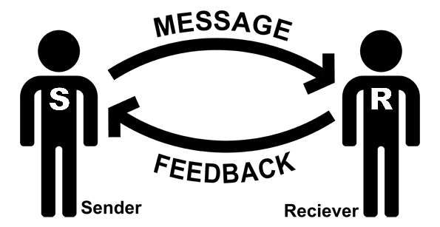
Two-Way Communication
4-3

Slide 33



Three Levels of Listening
Attentive
Responsive
Empathic
4-4

Slide 34
Attentive Listening
Actions that show you are paying attention:
Saying “yes” or “uh huh”
Nodding
Maintaining eye contact
Leaning toward speaker
4-5

Slide 35
Responsive Listening
Involving yourself in the communication:
Paraphrasing…
“If I understand you correctly, you’re saying…”
Clarifying…
“Did you say…?”
Summarizing…
“So you will be creating a new procedure?”
4-6

Slide 36
Empathic Listening
Listening for and reflecting the speaker’s feelings and emotions is empathic listening.
Examples:
“It sounds as if this has been difficult
for you.”
“You seem pretty excited about the
project!”
4-7

Slide 37
Barriers to Effective Listening
4-8

Slide 38
Basic Feedback Options
Option 1.
Option 2.
Option 3.
Option 4.
Positive Feedback: Increases the likelihood behavior will continue
Constructive Feedback: Increases the likelihood behavior will stop or change
Negative Feedback: Hurts feelings and motivation
No Feedback: Makes the outcome uncertain
4-9

Slide 39

For Desirable behavior −
Positive Feedback
Positive and Constructive Feedback
For Undesirable behavior −
Constructive Feedback
4-10

Slide 40
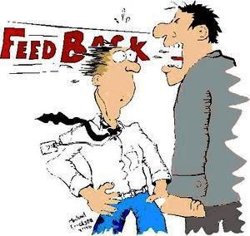
Negative Feedback
Classic negative feedback often fails to be constructive because it raises too many negative emotions.
4-11

Slide 41
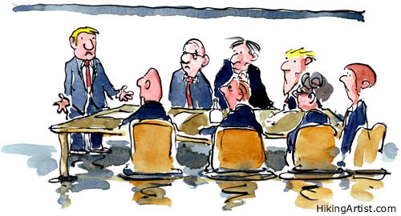
No Feedback
Giving no feedback makes the outcome uncertain and undermines confidence in the leader. It also sends a signal that the task must not be important.
4-12

Slide 42
Good Feedback Is…
Descriptive: Describes performance, not inferences or opinions
Specific: Provides details, not vague generalities
Constructive: Provides guidance for future performance
Timely: Feedback is given soon after performance for greatest impact
Considerate: Does not hurt feelings
4-13

Slide 43

Positive Feedback
Reinforces behavior that helps the employee meet job objectives
Builds confidence
Enhances motivation
4-14

Slide 44
Ineffective Responses to Undesirable Behavior
Avoiding Confrontation
Overreacting
Complaining
Lecturing
Padding
4-15

Slide 45
Giving Constructive Feedback
Let the employee know:
What specific behavior or result you don’t like and why
What you want and the benefit
Examples:
“I’m not happy that the project reports are a day late. This gets everyone off schedule and we miss our deadlines.”
“Don’t do as much review of the project once it is basically finished. This will enable us to meet our schedules and deadlines and it will be less review work on your part.”
4-16

Slide 46


Constructive Feedback Tips
Build a working relationship that facilitates open communication—talk often.
Balance with positive feedback.
Balance with positive feedback.
Prepare for the interaction (plan).
Consider how to deal with the employee’s reactions.
Ensure privacy and a non-threatening setting.
4-17

Slide 47
When Not to Lead
(Attitude/ Personality Mismatch)
(Complete
Mismatch)
Unacceptable
Progressive Discipline or Reassignment
Apply
Improvable
Good
Constructive
Leadership
Strategies
Apply
Employee
Attitude
(Skill
Mismatch)
Good Improvable Unacceptable
Employee Competence
4-18

Slide 48
Secrets of Stretching
Visualize high expectations for employees
Gradually reduce the level of supervision
Gradually increase the complexity and importance of tasks
Celebrate each stepping stone achievement to maintain/improve morale
4-19

Slide 49
Module 4 Summary
Coaching is used with employees who are
not performing well (a combination of competence/task and desire/attitude issues).
The Coach strategy requires high amounts
of both task focus and support behaviors.
Key supportive behaviors used in the Coach strategy include listening, asking for input,
and providing positive and constructive feedback.
4-20

Slide 50
Module 4 Summary (continued)
Listening encourages sharing information
and feelings, allows you to check your understanding of information, and helps
build trust and positive relationships.
Asking for input encourages employee involvement in thinking and decision making.
Feedback should be descriptive, specific, constructive, timely, and also considerate of their feelings.
4-21

Slide 51
Module 4 Summary (concluded)
Positive feedback maintains or increases desirable behavior and promotes confidence.
Constructive feedback maintains the employees’ self-esteem while stopping undesirable behavior.
High expectations help the leader “stretch” employees.
4-22

Slide 52
Relate Strategy
High
Leader’s
Focus
Low
Context:
C3 – Capable but unwilling/ insecure
Leader’s Goal:
To build employee confidence and commitment
Performance
Performer
C = Capacity
5-1

Slide 53
Self-Confidence
Self-Motivation
Task Meaningfulness
(purpose, impact)
5-2

Slide 54
Behaviors that Promote
Self-Confidence | Meaningfulness
Set attainable goals Praise achievements Express confidence in employees Recognize intermediate goals/ accomplishments Share feedback from customers | Explain how the task contributes to the overall plan Take an interest in the work Tell about employee accomplishments
5-3

Slide 55
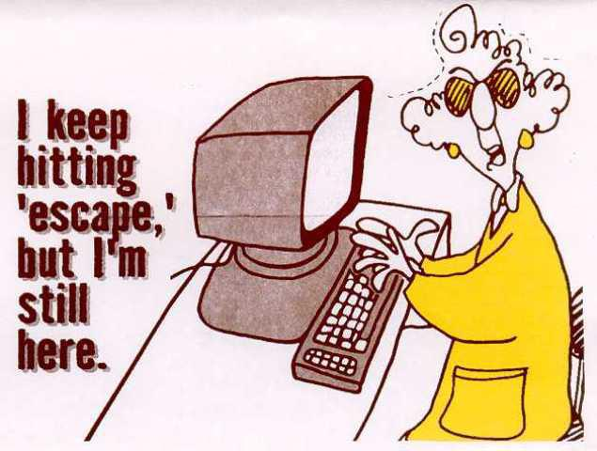
Creating a Considerate Environment
People do not like to work in places where other people are rude, inconsiderate, or unfriendly.
5-4

Slide 56

Reacting to Ideas
How you react to your employee’s ideas and suggestions will either promote continued sharing and synergy of ideas or hinder the process.
5-5

Slide 57
Listening and Reacting
5-6

Slide 58

Reacting Skills
Agreeing
Disagreeing Constructively
Building on Ideas
5-7

Slide 59
Module 5 Summary
The Relate strategy is used with employees who are capable but unwilling and/or insecure.
Relating uses few directive behaviors and many supportive behaviors to build confidence and increase motivation.
Involving employees in problem solving, planning, and decision making demonstrates confidence.
5-8

Slide 60
Module 5 Summary (concluded)
Employees lose motivation if they think they are being treated rudely.
Listening and reacting to employees’ ideas encourages involvement.
Reacting skills include agreeing, disagreeing constructively, and building on ideas.
5-9

Slide 61
Delegate Strategy
High
Leader’s
Focus
Low
Context:
C4 – Capable and willing/ confident
Leader’s Goal:
To encourage the employee
to work more independently
Performance
Performer
C = Capacity
6-1

Slide 62
Delegation…
Transferring to someone else a portion of your authority and responsibility while retaining accountability for the task.
6-2

Slide 63
Delegation Steps
4.
Keep in contact to provide help
as necessary
3.
Give the person the resources and authority to do the job
2.
Explain the Objectives
1.
Choose a capable, motivated person
6-3

Slide 64


Developmental Leadership:
Maximizes employee performance on the current task.
Helps employees grow and develop so they can tackle even greater challenges in the future.
6-4

Slide 65
Employee Development Cycle
6-5

Slide 66
Module 6 Summary
The Delegate strategy is used with employees who are capable and self-motivated.
Delegation is transferring a portion of your authority and responsibility while remaining accountable.
Delegation benefits employees, leaders, and the organization.
6-6

Slide 67
Module 6 Summary (concluded)
The delegation process involves choosing a capable person, explaining objectives, giving the person resources/authority, and providing support as needed.
Developmental leaders try to keep employees moving through the other strategies and toward delegation—then introduce a new challenge and start the process again.
6-7

Slide 68

What Leadership Strategy Does Your Employee Need?
The strategic leader selects a strategy before acting
The strategy is based on employee needs
The leader looks at two key areas of need: capability and attitude
Does she know how to do the task well?
Does she want to do the task well?
7-1

Slide 69

Capacity =
capability + desire
to perform
7-2

Slide 70
SLTI Case 3.
CASE 3.
In the middle of an important project, one of your team members quits. The new replacement is eager to help out, but lacks experience. Will she perform well if you…
A. Let her know what her duties are so that
she can take on her new responsibilities as
quickly as possible.
Show her how to do the work, and also give her extra attention and encouragement to increase her motivation?
Give her more sympathy, attention, and encouragement at first to help her with the transition?
Show her exactly what to do, then correct her work whenever she gets confused and approve it when it is correct?
7-3

Slide 71
Strategic Focus is Based on Need(s)
Low
Employee
Desire to
Perform
High
Employee needs work only on attitude, motivation | Employee needs work on both attitude and capability
Employee does not need work on capability or attitude | Employee needs work only on capability
CASE 3
High Employee Capability Low
to Perform
7-4

Slide 72
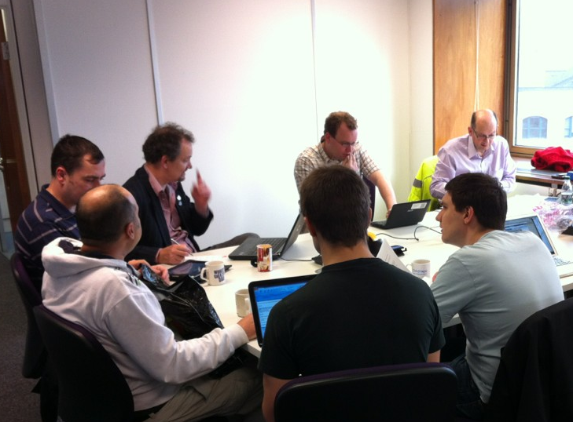
Selecting the Best Strategy
What does the leader need to do if employees are not capable?
Give information, briefings, examples, and check the work: Instruct.
This strategy focuses on teaching the task.
It assumes employees want to master the task, so it does not worry very much about their attitudes.
Case 3: Show and Tell with the Instruct strategy.
7-5

Slide 73
How to Select the Best Strategy
1
Low capability
High desire
Use
INSTRUCT
2
Low capability
+ Low desire
Use
COACH
3
Low desire
High capability
Use
RELATE
4
High in both
areas
Use
DELEGATE
2
3
Leader shifts between strategies based on need.
1
4
7-6

Slide 74

3-Step Strategic Leadership Process
Do they know how to do it well?
Do they want to do well?
3
2
4
1
Instruct
Coach
Relate
or
Delegate?
1. Assess capability and desire
2. Select
strategy
3. Plan how to
implement
7-7
Notes:
Slide 46.
46a. This is a summary of the three-step process you need to go through in order to make sure your leadership behaviors are strategic.
46b. The practice case starting on page 16 asks you to use this process.

Slide 75

Implementation
A Strategic Leader helps employees deal with anxieties associated with unexpected change, focusing on the people issues rather than the tasks.
8-1

Slide 76
Implementation Ideas: Relate
Share relevant information
Lead a discussion of concerns
Offer “effort” rewards
Give one-on-one pep talks
Throw a pizza party
Others? Leadership “menu” needs to be extensive for good implementation
8-2

Slide 77
Idea: Build a Behavior Database
!
A “Leadership Actions Database” collects many examples of appropriate leader behaviors.
It becomes strategic when organized usefully; for example, by which strategy each action relates to.
8-3

Slide 78
SLTI Answer Sheet
Rating Scale: (How well would each response work based on its own merit?)
Definitely Probably Possibly Probably Definitely
Not
Not
1
2
3
4
5
Example Case
You are in a building with a strong smell of smoke. Your goal is to make sure your employees are safe. Will it work if you… | Pull the fire alarm? Look for the source? Fight the fire yourself? Leave the building without telling anyone? | 1. | A. B. C. D.
1
2
3
4
5
1
2
3
4
5
1
2
3
4
5
1
2
3
4
5
Shade in the letter of your response to each option.
A-1

Slide 79

Recording Your Scores, Step 1
A
1
2
3
4
5
4
B
1
2
3
4
5
1
C
1
2
3
4
5
4
D
1
2
3
4
5
2
A-2

Slide 80
Recording Your Scores, Step 2
+
C
1
2
3
4
5
3
D
1
2
3
4
5
2
A
1
2
3
4
5
4
+
B
1
2
3
4
5
1
C
1
2
3
4
5
4
D
1
2
3
4
5
2
=
Enter column total here
D
A-3

Slide 81
Recording Your Scores, Step 3
Example: The total of the two “I” column scores is your Instruct score.
A-4

Slide 82
Interpreting Your Scores
Dominant Strategy Type Matrix
A-5

Slide 83
Interpreting Your Scores (concluded)
Development Path
□
□
□
□
Instruct (I) May need to give employees more information and structure
Coach (C) May need to focus on helping employees improve
Relate (R) May need to give more support
Delegate (D) May need to give employees more responsibility
A-6

Slide 84
Strategy Variability Scale
0 – 5 | High
6 – 10
11 – 15 | Medium High
16 – 20
21 – 25 | Medium Low
26 – 30
31 – 35 | Low
36 – 40
41 – 45 | Very Low
46+
A-7

Slide 85
Strategy Effectiveness
16 | High
15
14
13
12 | Medium High
11
10
9
8 | Medium Low
7
6
5
4 | Low
3
2
1
A-8

Slide 86
Strategic Leadership
3
2
4
1
Adjusting your approach to reflect employee capabilities and desires
B-1

Slide 87
A Strategic Role for Leaders
Employees have varied needs based on the work they are doing and what skills and attitudes they bring to it.
Strategic leadership responds to
these varying needs with appropriate strategies to guide the leader’s efforts.
B-2

Slide 88
A Strategic Role for Leaders
(concluded)
The leader chooses from a handful of general strategies, then uses judgement, experience, and creativity to find (many) good ways to implement the strategy, depending on the circumstances.
B-3

Slide 89
Management versus Leadership
To manage can mean simply to be in charge, to control, or to take responsibility
Leadership usually means to inspire, to motivate, or to help others achieve important goals
B-4

Slide 90
Analyzing Your Results, Step 1
A
1
2
3
4
5
4
B
1
2
3
4
5
1
C
1
2
3
4
5
4
D
1
2
3
4
5
2
B-5

Slide 91

Analyzing Your Results, Step 2
+
C
1
2
3
4
5
3
D
1
2
3
4
5
2
A
1
2
3
4
5
4
+
B
1
2
3
4
5
1
C
1
2
3
4
5
4
D
1
2
3
4
5
2
=
Enter column total here
D
B-6

Slide 92
Analyzing Your Results, Step 3
Example: The total of the two “I” column scores is your Instruct score.
B-7

Slide 93
Developmental Leadership
Seeks to increase both desire and capability to perform (increase employee’s performance capacity)
Moves employees toward “Delegate”
on each task (self-management)
Seeks to expand their set of skills with varied tasks (stretching)
C-1

Slide 94

Taking Aim: Develop by focusing on employee’s key issue
Off center
On-target leadership behaviors
Off center
C-2

Slide 95
Sequences of Strategies
3
2
4
1
Relate
Coach
When you focus on employee needs in relation to a specific task, you help the employee master that task.
Anticipate changing needs as the employee develops, and be prepared to change your strategy too.
Delegate
Instruct
When the employee masters a task, introduce another.
C-3

Slide 96
Is there a fixed Development Cycle?
Some employees need to cycle through the four strategies in order as they develop mastery of a task.
Motivation is not easily predictable over the period that employees learn to master a task. Why not? Discouragement might set in at any point; some tasks are easier to learn.
It is best to assume you need to check needs and respond flexibly. Sometimes you can Instruct, then go right to Delegate. Other times, it is more complex and you might need to use all of the styles on the way to mastery.
C-4

Slide 97

Developmental Leadership Practices
Add responsibilities to increase the challenge level?
Encourage employee self-sufficiency?
Strive for variety of tasks and skills?
Discuss employee development goals?
?
C-5

Slide 98
Case 1
You have just received surprising information that requires your group to take a new approach right away. You know the group members are good enough to handle the changes, but they may feel anxious about it at first.
D-1

Slide 99
Case 2
Recently, several employees have resigned from your place of work and one remaining employee in particular has to do more work as a result. You know he is capable of handling the challenge, but right now he is angry about the situation.
D-2

Slide 100
Case 3
In the middle of an important project, one of your team members quits. The new replacement is eager to help out, but lacks experience.
D-3

Slide 101
Case 4
A recently promoted employee is producing disappointing results. Although she works hard, she does not seem to realize when her work is inadequate.
D-4

Slide 102
Case 5
An employee made a series of mistakes that suggested she does not understand a technical point about her work. You tried to give her some constructive feedback, but she reacted defensively. Before you knew it, you found yourself arguing with her and you criticized her work more broadly than you had meant to. Now she is upset and angry.
D-5

Slide 103
Case 6
Employees have been well trained in how to achieve new quality goals, but they don’t seem to be taking the goals seriously.
D-6

Slide 104
Case 7
An employee continues to struggle in spite of your efforts to teach him how to do his work. His attitude is increasingly negative too.
D-7

Slide 105
Case 8
You usually hold a morning meeting in which you give each employee their assignments for the day, but lately your group has been performing so well and with such enthusiasm that you wonder if it is really necessary.
D-8

Slide 106
Case 9
An employee has not submitted monthly progress reports since your firm introduced a more complex version of the report form. He avoids talking to you about it and seems less happy than he used to be with his job.
D-9

Slide 107
Case 10
You have recently taken over a group of employees who are experienced at their work and seem to take their responsibilities very seriously.
D-10

Slide 108
Case 11
An employee is having trouble learning how to do a new task, but his attitude is positive and he assures you he will keep trying until he succeeds.
D-11

Slide 109
Case 12
A good employee approaches you, asking for more responsibility. Her work is superior and she has a positive attitude, but you don’t want to lose control over the work in your department.
D-12

Slide 110
Case 13
An experienced, enthusiastic employee has volunteered to learn a difficult software program. You are the only one who knows how to use it.
D-13

Slide 111
Case 14
New equipment is causing a lot of errors and slowdowns, and employees are complaining that they don’t want to have to learn how to use it.
D-14

Slide 112
Case 15
A team of employees is skilled and experienced, but seem to be having conflicts and disagreements that get in the way of their work.
D-15

Slide 113
Case 16
An employee has just come to work for you from another location. Although new, he seems to have done most of the work before, and in fact has some good new ideas and approaches. You are pleased with his can-do attitude.
D-16

